Slide 1



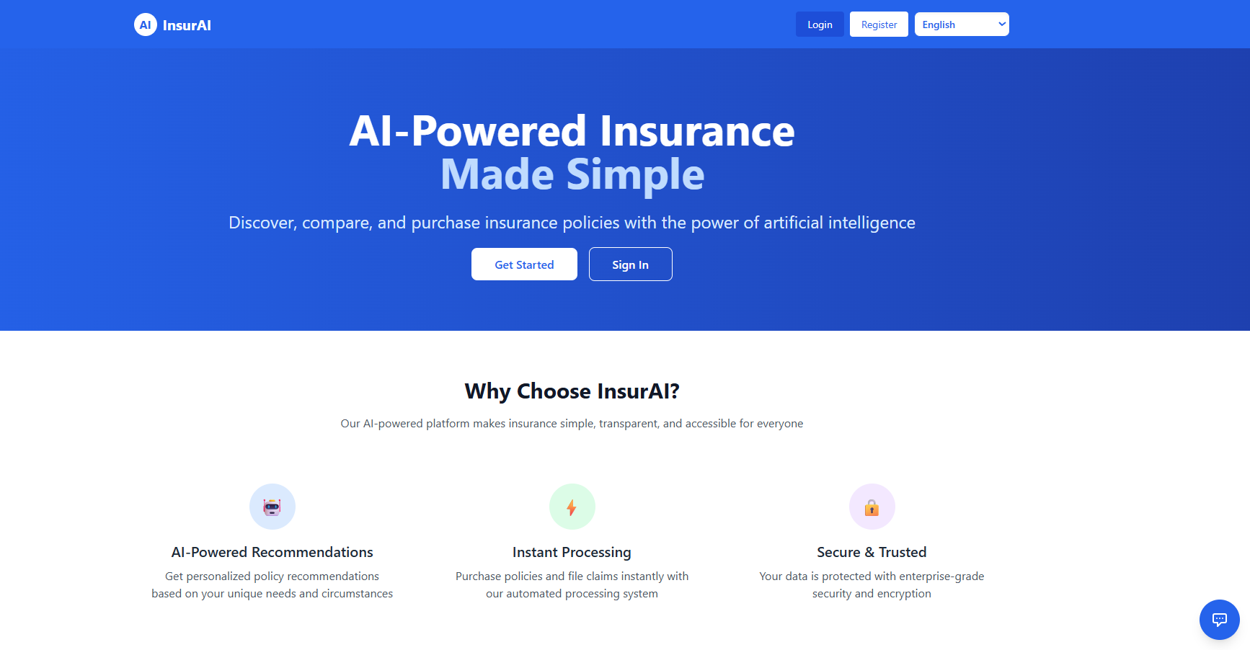



INSURAI:
CORPORATE POLICY AUTOMATION AND INTELLIGENCE SYSTEM
Subtitle :
Automating Insurance Policy Management with AI
Presented by :
Eshita Talukdar
Date :
07/10/2025

Slide 2


Table of Content
01
Introduction
08
AI Integration
02
Objectives
09
Security Implementation
03
System Overview
10
Feasibility Analysis
04
Functional Modules
11
System Requirements
05
User Modules
12
System Architecture
06
Admin Modules
13
Visual Demonstrations
07
Technology Stack
14
Conclusion & Future Scope

Slide 3

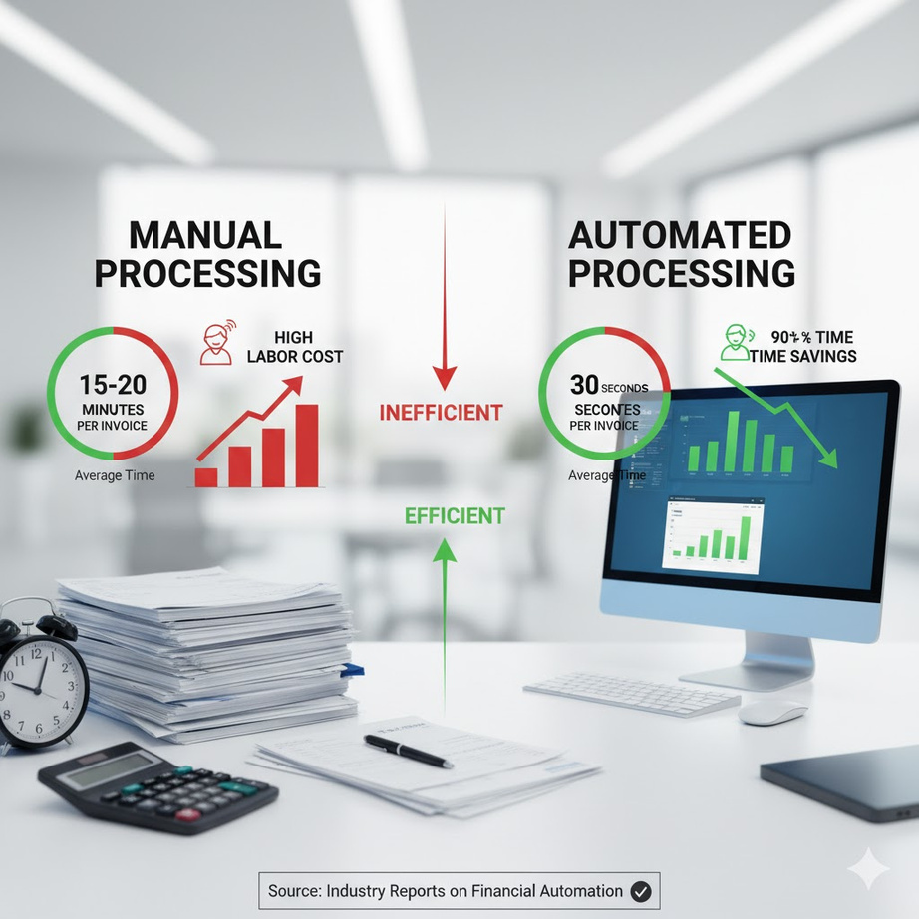

Introduction
Manual insurance management is slow, prone to errors, and resource-intensive, leading to high operational costs and poor customer experience
InsurAI aims to automate key insurance operations such as policy creation, renewal, claims, and analytics.
The platform integrates AI, automation, and analytics to streamline decision-making and customer service.
Automation Focus: Policy Creation, Claims Processing, and Real-time Reporting.

Slide 4



Objectives
Automate complete policy lifecycle (creation → renewal → expiration).
Simplify claims submission and tracking for users.
Provide real-time insights and analytics to admins.
Enable AI-powered assistance for both users and administrators.
Ensure secure, scalable, multilingual access.

Slide 5











System Overview
Web-based application with two roles: User & Admin.
Common landing page for all users (hero section, why trust us, policy browsing).
Role-based dashboards with unique privileges.
Integration with Gemini AI Chatbot for intelligent Q&A.
Multilingual support: English, Hindi, Bengali

Slide 6


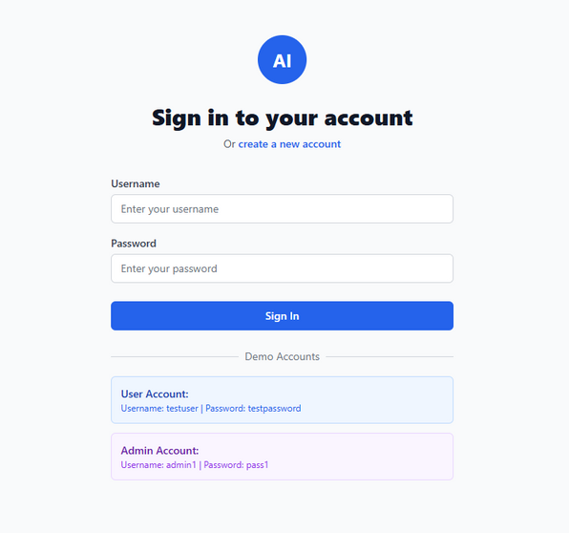
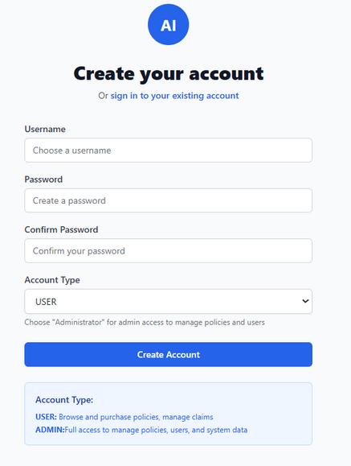
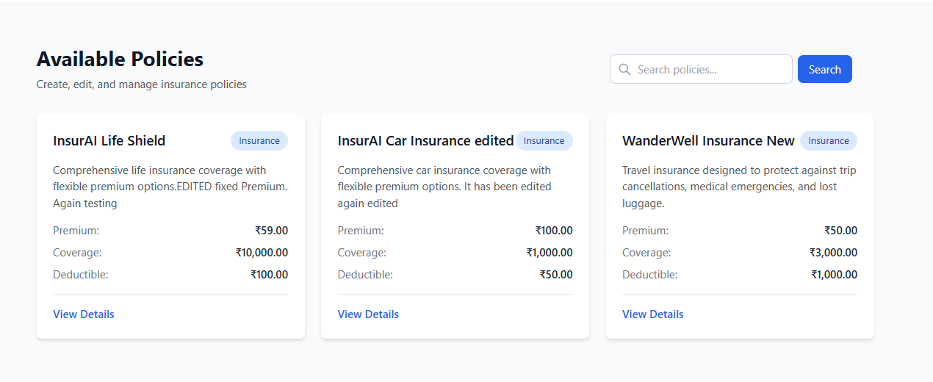


Functional Modules
Authentication
Login/Signup with JWT
Role-based access control
Landing Page
Hero & Trust Sections
Policy browsing (post login)

Slide 7

User-Side Modules
Dashboard:
Claims:
Active & expired policies
Monthly premium & total coverage
File claim
Track claim status
Policy Details:
Chatbot:
Policy name, remaining days, etc.
AI assistance for policies, claims & procedures

Slide 8


Admin-Side Modules
Dashboard Analytics:
Manage Users
Total policies, users, active purchases, and claims
Weekly user registrations & claims (via charts)
View, update, delete users
Manage Claims:
View, approve/reject, filter/search
Manage Policies:
Create, edit, delete, search
Report Analytics:
Pie chart, area & line graphs for trends

Slide 9



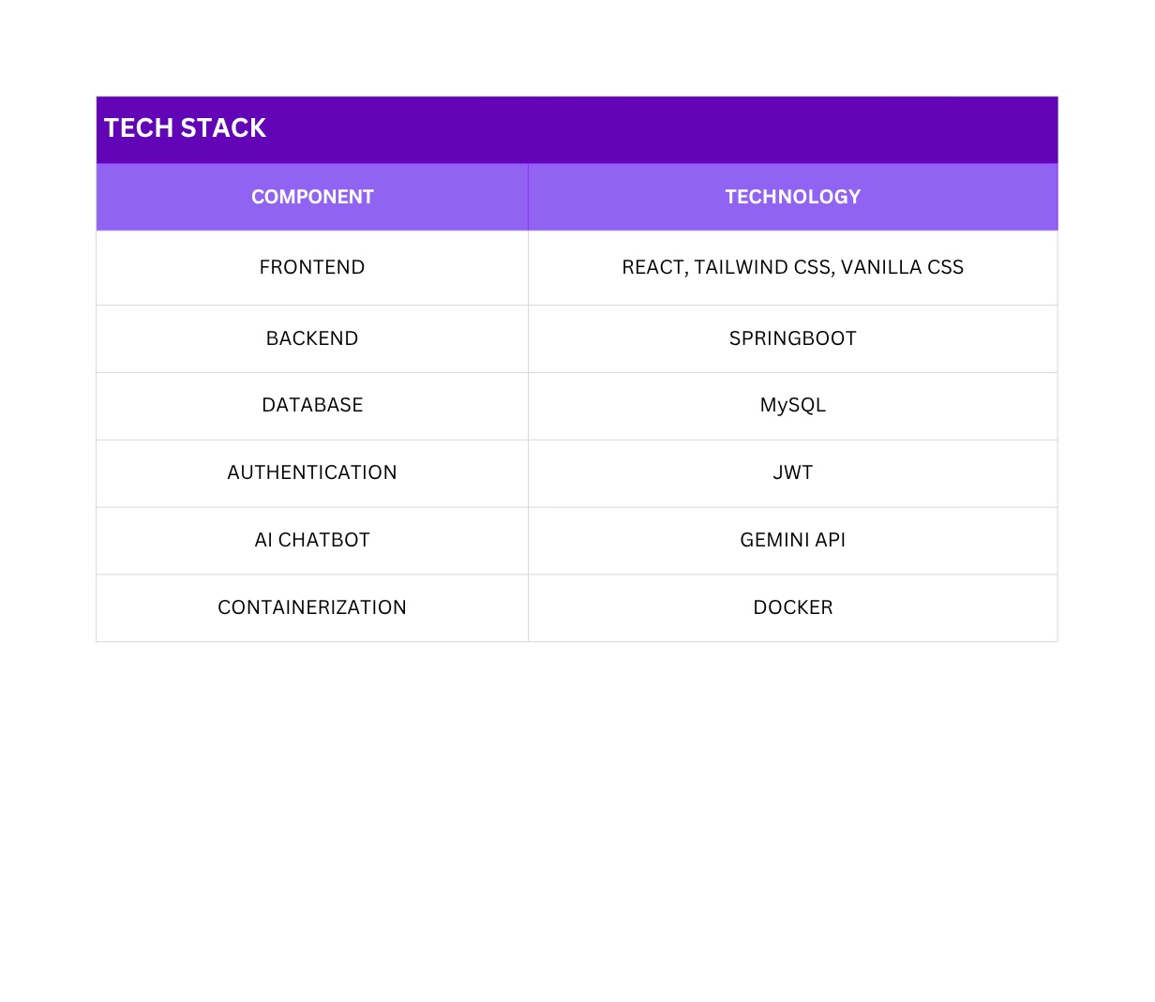
Technologies Used

Slide 10

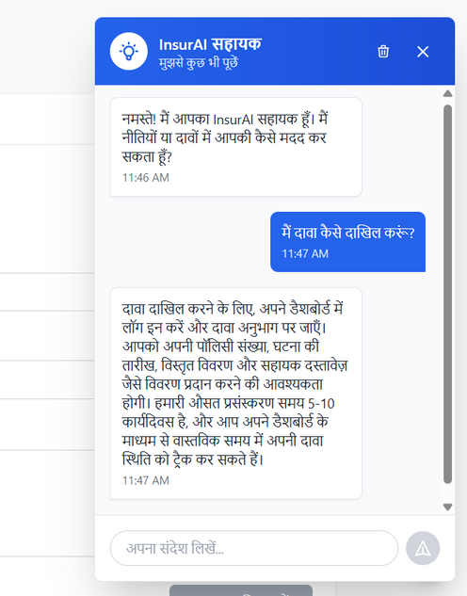
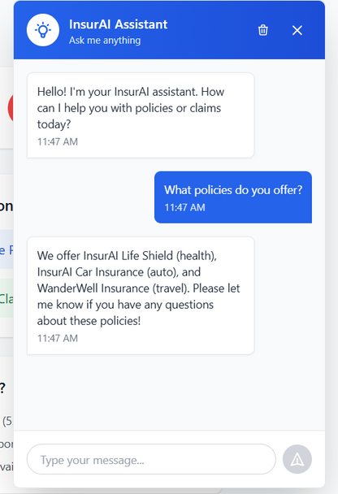
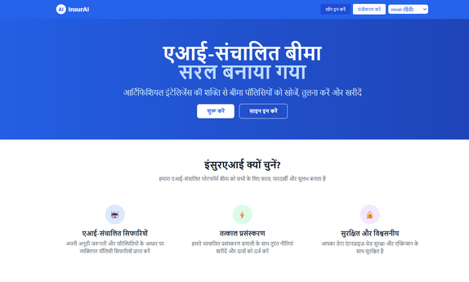
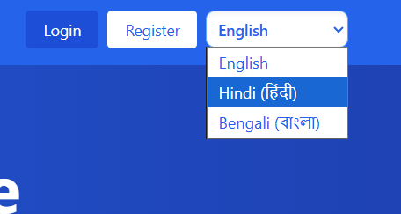


AI Integration
Gemini API (via Spring AI) powers chatbot responses.
Handles domain-specific queries on:
Policies
Claims process
Application usage
Supports multilingual responses (English, Hindi, Bengali).

Slide 11
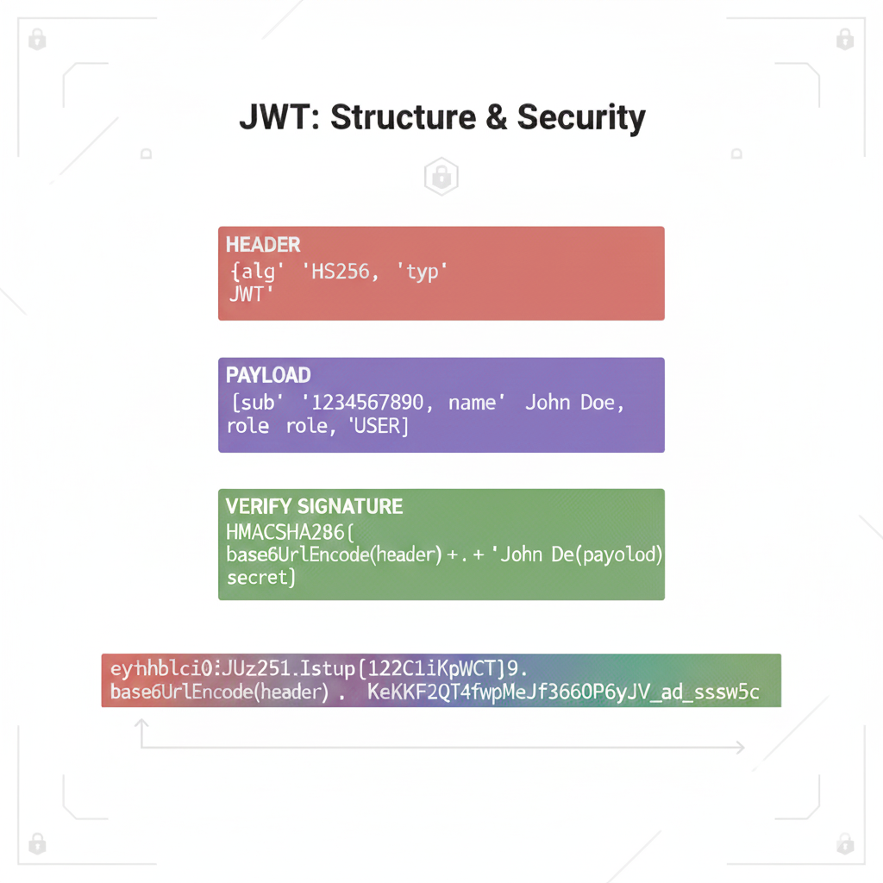
Security Implementation
JWT-based Authentication & Authorization
Role-based Access Control
Encrypted communication (HTTPS)
Compliance with data privacy standards

Slide 12
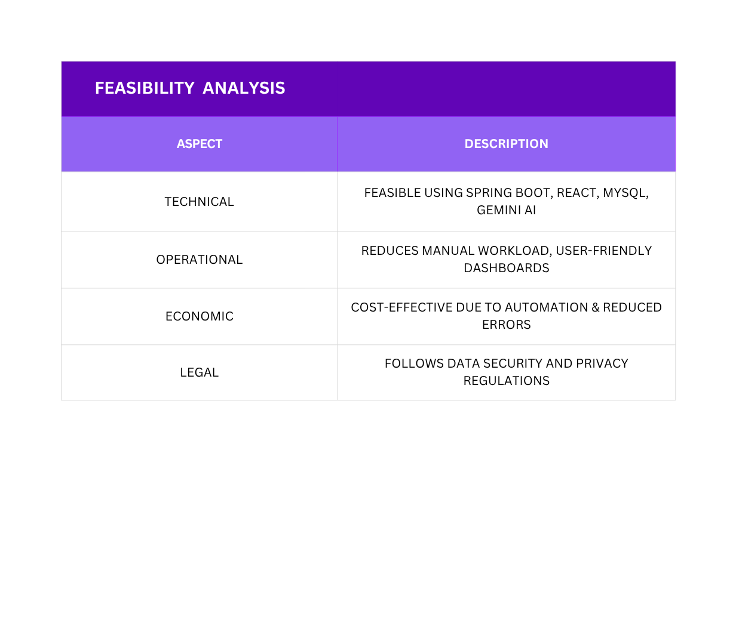
Feasibility Analysis

Slide 13
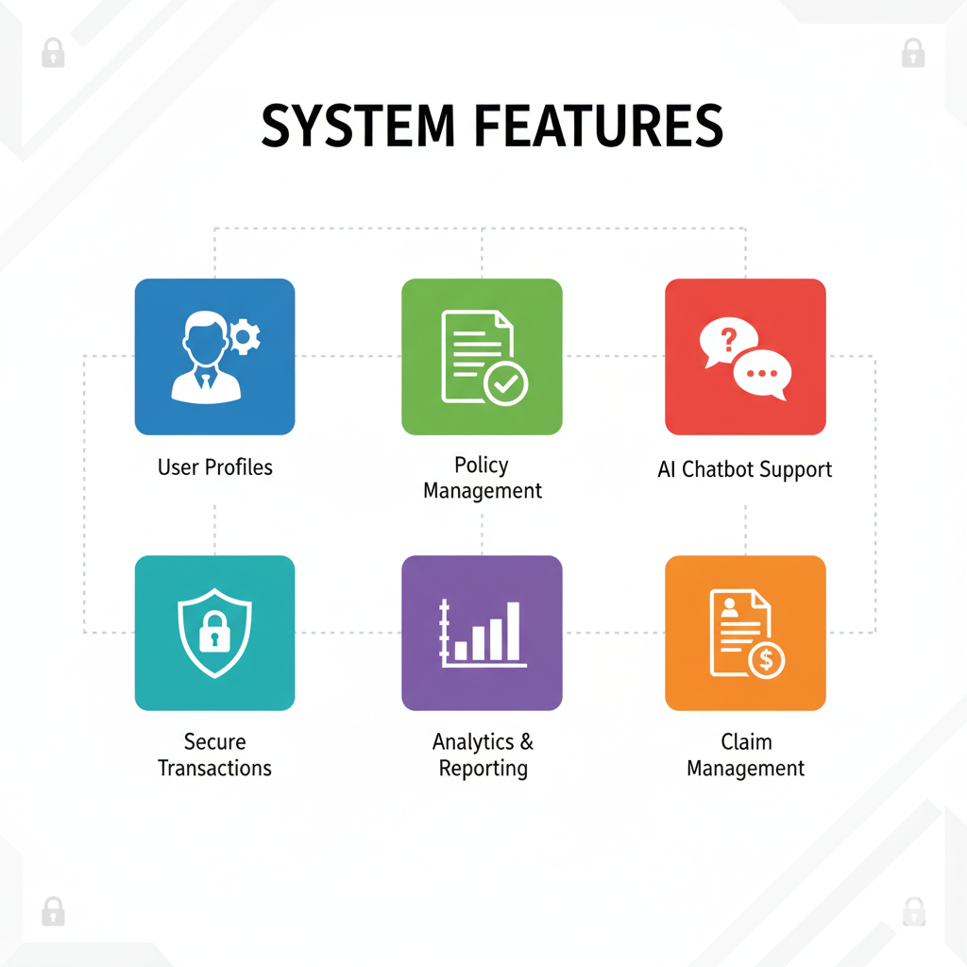
System Features
Functional: Authentication, Policy Management, Claims, Payments, Analytics
Non-Functional: Performance, Scalability, Security, Usability, Availability, Maintainability
Constraints: Limited workforce, third-party API dependency, web-only MVP

Slide 14
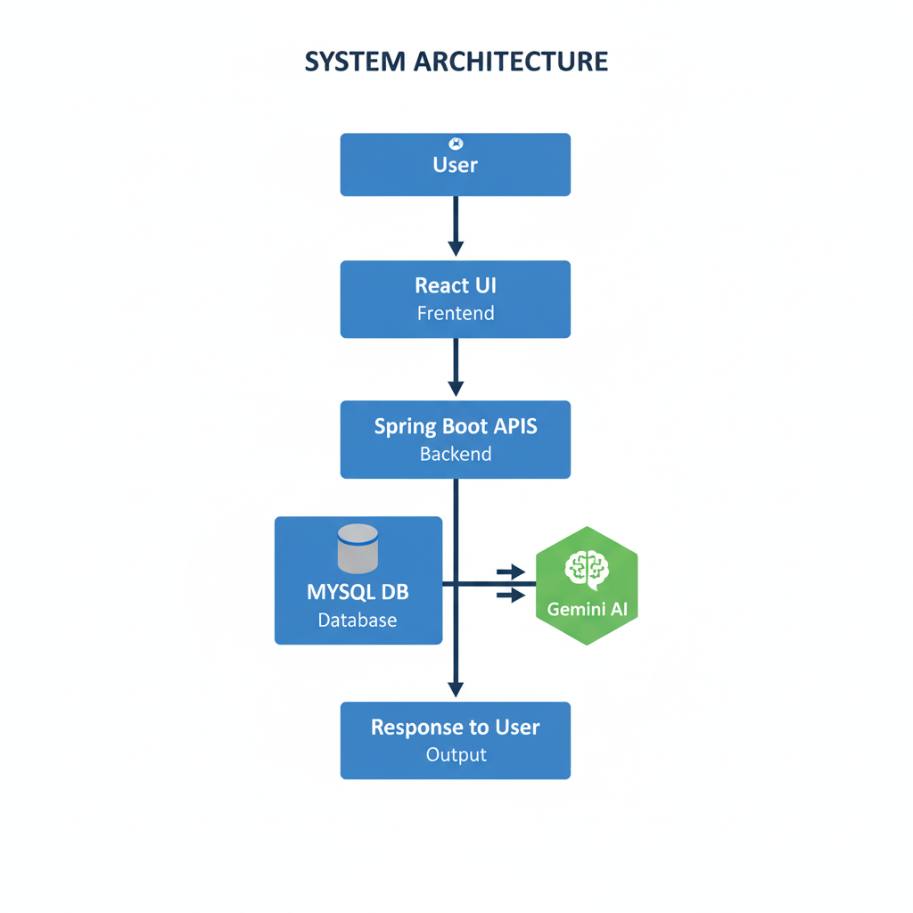
System Architecture
The system follows a request–response model:
The user interacts with the web interface (login, claim submission, chatbot).
The frontend sends HTTPS requests to backend REST APIs.
The backend validates requests using JWT tokens and applies business logic.
Relevant data is fetched or updated in the MySQL database.
The AI chatbot communicates with Gemini API for intelligent responses.
Processed data and results are returned to the frontend for user display.

Slide 15
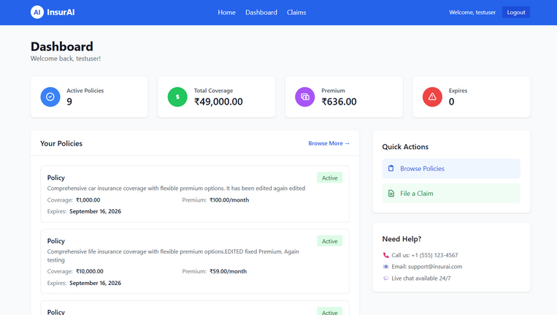
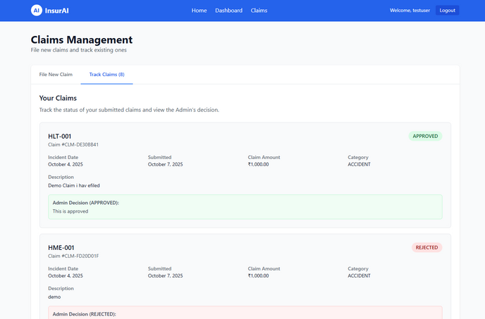
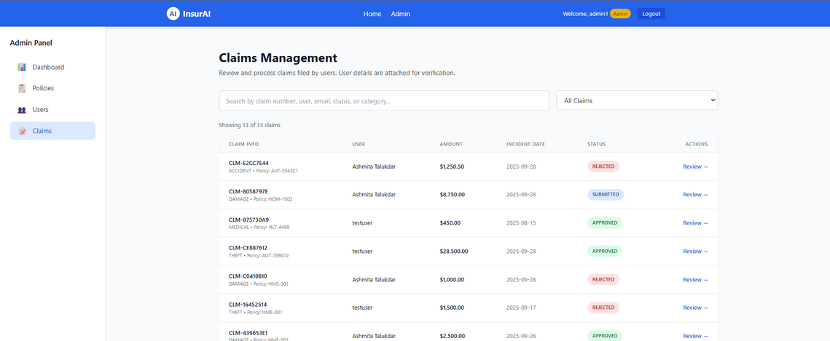
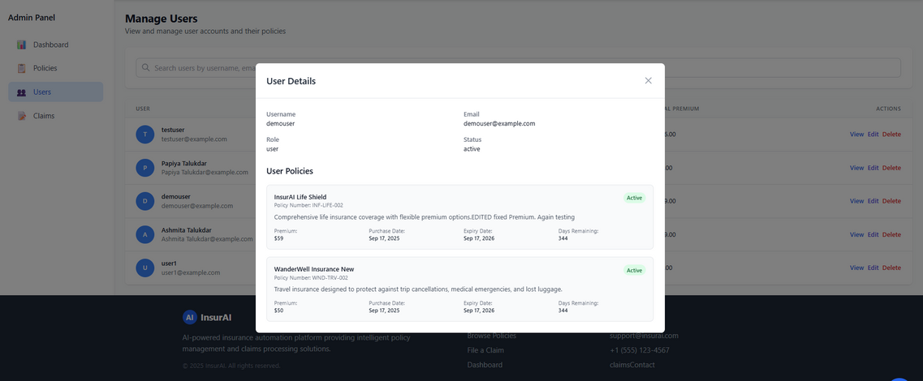
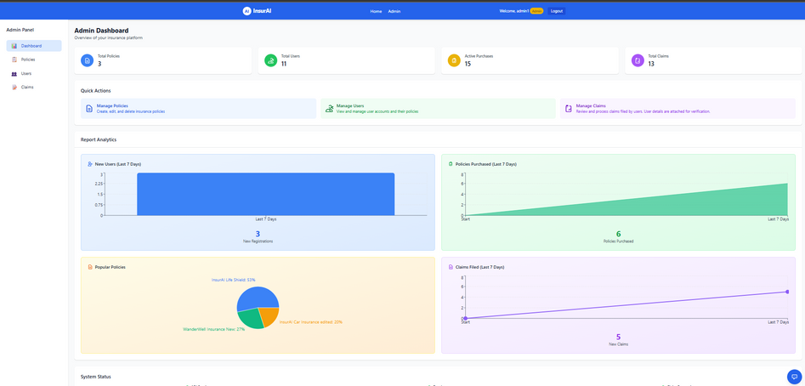
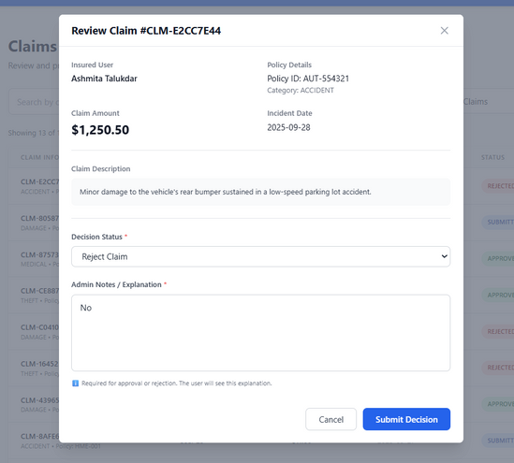
Visual Demonstrations
USER DASHBOARD :
USER CLAIM TRACKING :
MANAGE CLAIMS (ADMIN) :
MANAGE USERS (ADMIN) :
ADMIN DASHBOARD :
CLAIM REVIEW (ADMIN) :

Slide 16

Conclusion & Future Scope
InsurAI successfully automates policy operations and enhances efficiency.
Reduces manual intervention, improves accuracy, and provides real-time insights.
Future Enhancements:
Mobile app version
Integration with payment gateways
Predictive claim approval using AI

Slide 17
THANK YOU
Presented by: Eshita Talukdar

